Slide 1
Manhattan Food Truck Project
Manjari Dissanayake

Slide 2
Business Idea
Why food business?
Demand for "Food" never decreases.
One of the most profitable and expanding type of businesses in the world.
Food Trucks
Food Trucks is one of the main attractions in Manhattan.
To setup less assets and investments needed.

Slide 3
Parameters in placing food trucks
Food Trucks must be placed near populated areas.
Ideal: Close to Monuments, Parks, Fountains, Schools, Apartment buildings etc.
Problem: We have 6 food trucks and need to find best places to place them.

Slide 4
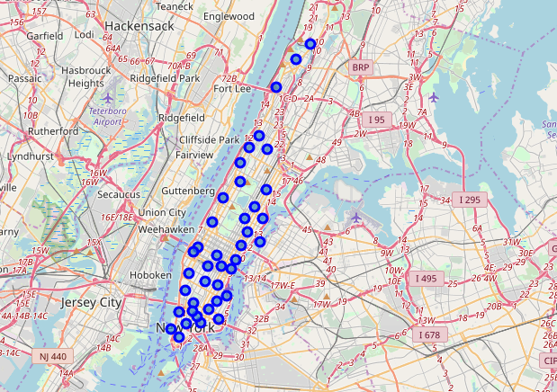
Approach
There are 40 neighborhoods in Manhattan.
Neighborhoods will be categorized into 6 clusters and in each cluster food truck will be placed on the best candidate neighborhood (ranking system).
Figure 01: Neighborhood locations in the Manhattan borough, NY

Slide 5
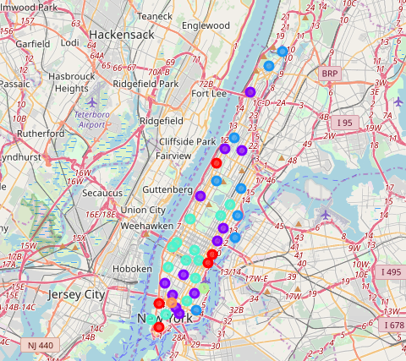
1. Clustering
We will cluster using k-means clustering (6 clusters)
Parameter: Mean of the frequency of occurrence of each type of venue in the top 20 most visited venues within 500 meter radius.
Figure 02: Six clusters of neighborhoods in Manhattan by their mean of the frequency of occurrence of each type of venue.

Slide 6
2. Ranking neighborhoods
Neighborhoods in each cluster will be ranked according to the score:
Score = 2*number of attractions – number of food places
Neighborhoods with 0 attractions in top 20 most visited places will be discarded in the analysis.
Neighborhoods with least negative score or largest positive score compared to other neighborhoods in the cluster are winners.

Slide 7
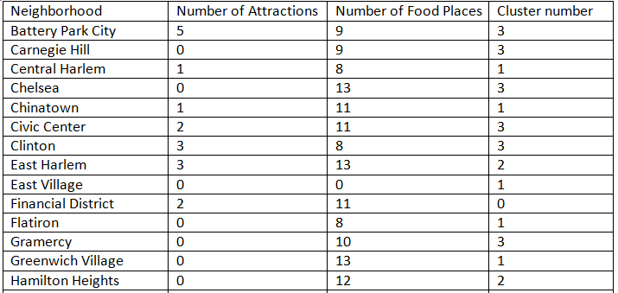
Results: Score and Cluster table
Table 01: Number of Attractions, number of food places and cluster number of neighborhood in the top 20 most visited places in each Manhattan neighborhood within 500 meter radius.(part)

Slide 8
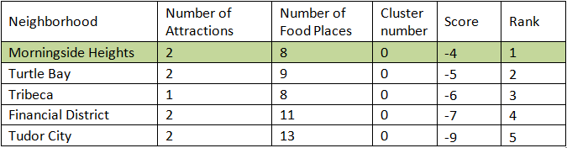
Results: Cluster-wise ranks
Table 02: Ranks of Cluster 0 neighborhoods.

Slide 9
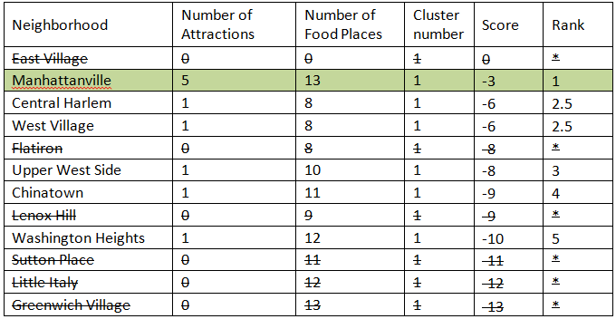
Results: Cluster-wise ranks
Table 03: Ranks of Cluster 1 neighborhoods (Neighborhoods with 0 attractions are discarded).
.

Slide 10
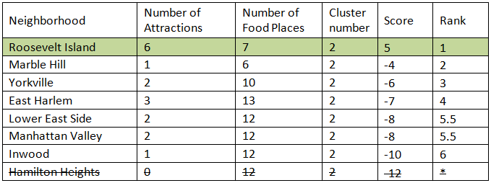
Results: Cluster-wise ranks
Table 03: Ranks of Cluster 2 neighborhoods (Neighborhoods with 0 attractions are discarded).

Slide 11
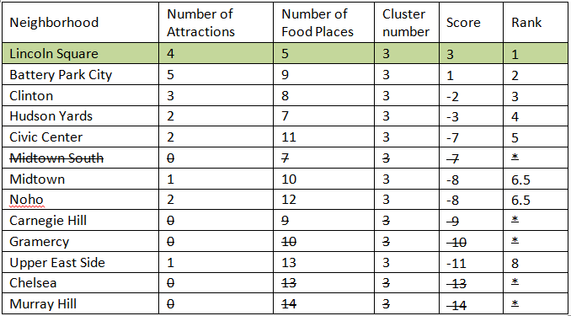
Results: Cluster-wise ranks
Table 04: Ranks of Cluster 3 neighborhoods (Neighborhoods with 0 attractions are discarded).
.

Slide 12


Results: Cluster-wise ranks
Table 05: Ranks of Cluster 4 neighborhoods
Table 06: Ranks of Cluster 5 neighborhoods

Slide 13
Conclusion
Food truck winning neighborhoods:
Morningside Heights
Manhattanville
Roosevelt Island
Lincoln Square
Stuyvesant Town
Soho

Slide 14
Discussion
Some clusters have many competing neighborhoods with positive scores than winning neighborhoods in other clusters.
Ex: In cluster 3 Battery Park which a large positive value.
Sometimes placing a food truck in Battery Park could be advantages than placing food trucks in Morningside Heights, Manhattanville or Soho that has negative scores although they are cluster winners.

Slide 15
Thank you

